Slide 1

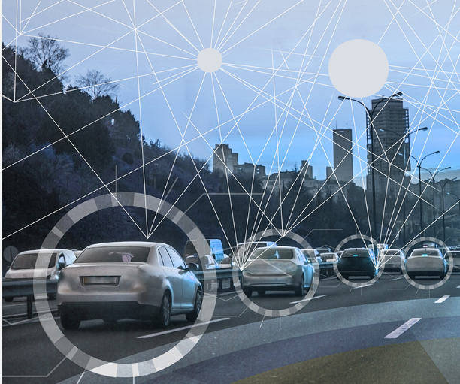
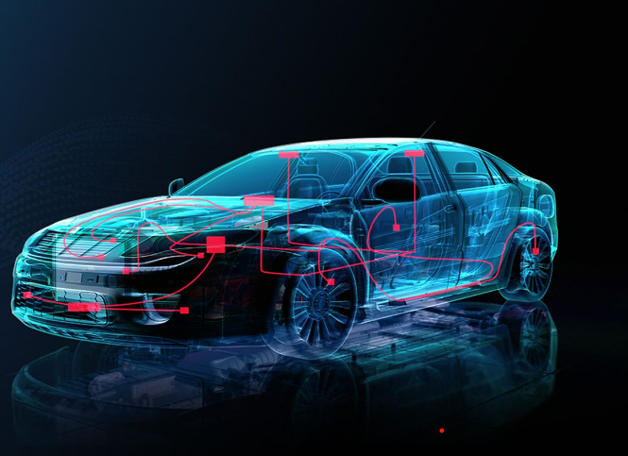
Predicting Model For Prices of Used Cars
By :
Anuj Kumar
Pappu Kumar
Vibrin R

Slide 2

Agenda:
Project overview
Data collection
Data cleaning
Exploratory data analysis
Prediction modeling

Slide 3
Problem Statement
Problem Statement :
Used cars sales are globally increase. There is a need for used car price prediction system to determine the business finance and customer purchase.
Solution :
A model can be developed to predict and assign that price to the vehicle.
To effectively determine the worthiness of used cars by studying variety of features.
Result :
To predict the actual value of cars considering various parameters that helps both buyers and sellers.

Slide 4


Our Motive
The aim is to build a model that can accurately predict the price of a used car, based on the data available, in order to assist buyers and sellers in making informed decisions.
The model analyze the current market trends and provide insights into the most important factors affecting the price of a used car.
The model will be trained on a large dataset of used car sales, and evaluated using various performance metrics to ensure its accuracy and reliability.

Slide 5
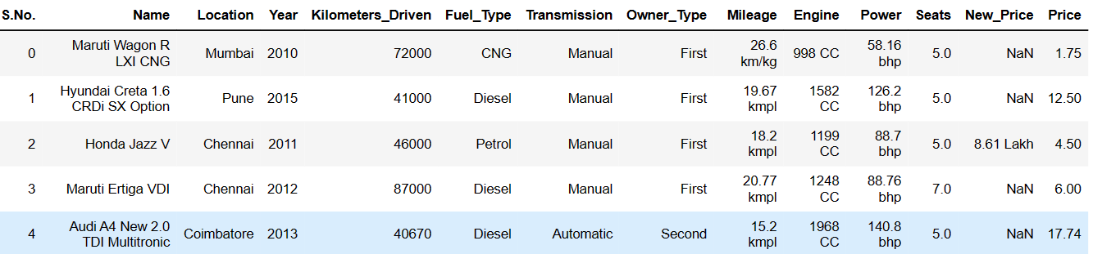
Data Collection
We used the kaggle website for scrap the data of used car listing (Cardekho).
Dataset consists of 7253 car details.
Columns consists of(14 columns):
Our target variable Price depend on various conditions, Body condition, Mechanical condition, Seller type, Transmission type, Regional spec, Horsepower, Fuel type, Year, emirates, Company, Model, Kilometers_Driven.

Slide 6
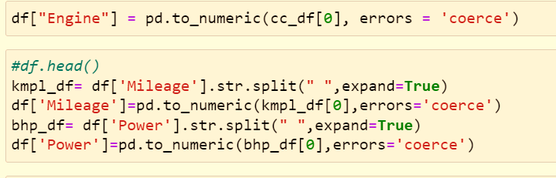
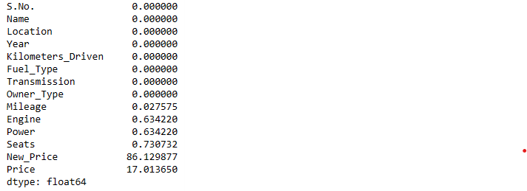
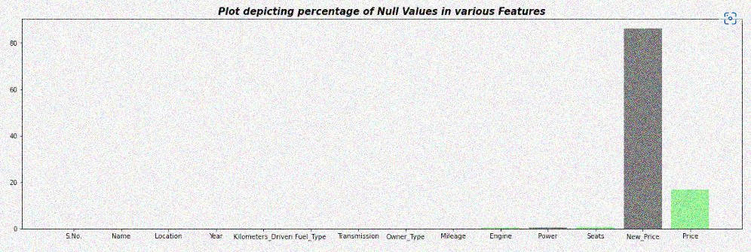
Data Cleaning
Removing the Units of Engine, Mileage, Power
Percentage of missing Data
The dataset has been checked for duplicates, null values and data types.
The New Price Column has been dropped as it has maximum null values
The Units of Mileage, Engine, Power is there with the value which is not necessary and can be removed, the missing values are filled with median and the duplicates have been dropped

Slide 7
Exploratory Data Analysis
We performed EDA on our data to gain insights into the distribution, relationships, and patterns in the data. Used visualizations such as histograms, scatter plots, and others to help us better understand our data.
Feature Engineering: Identify which columns might be useful in predicting used car prices and create new features from the existing columns. For example, created column Manufacture form the name column also for column year.
Handle missing values
Encode categorical variables
Split the data into training and testing sets
Choose and train a model
Evaluate the model
performance.

Slide 8
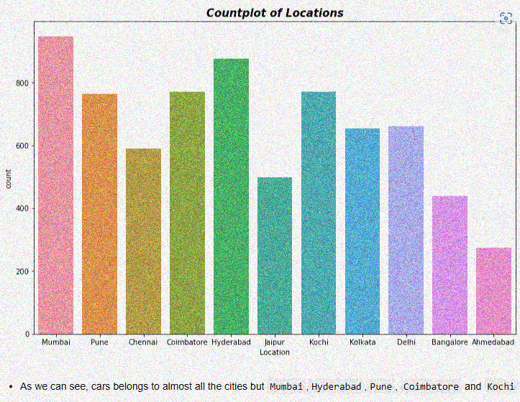
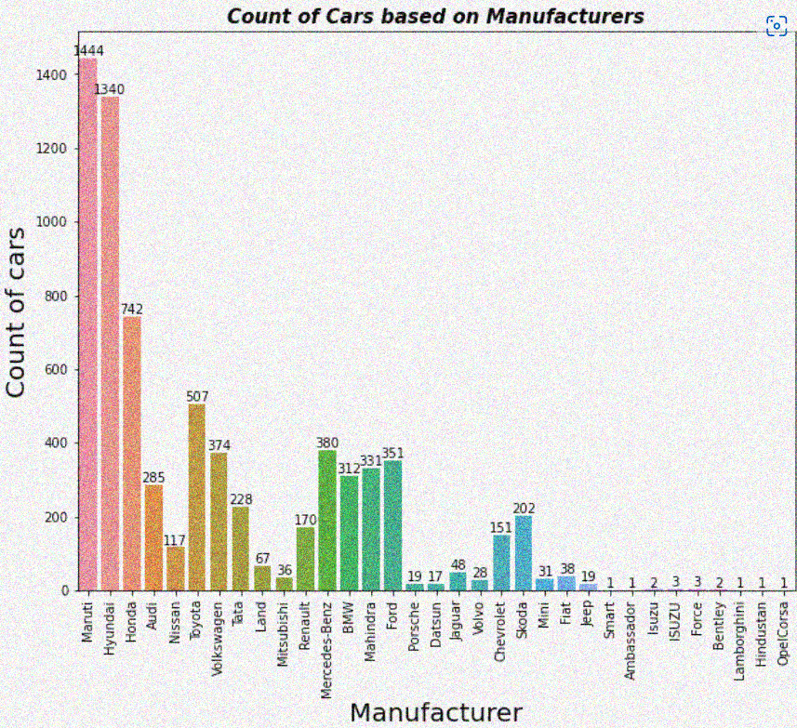
EDA

Slide 9
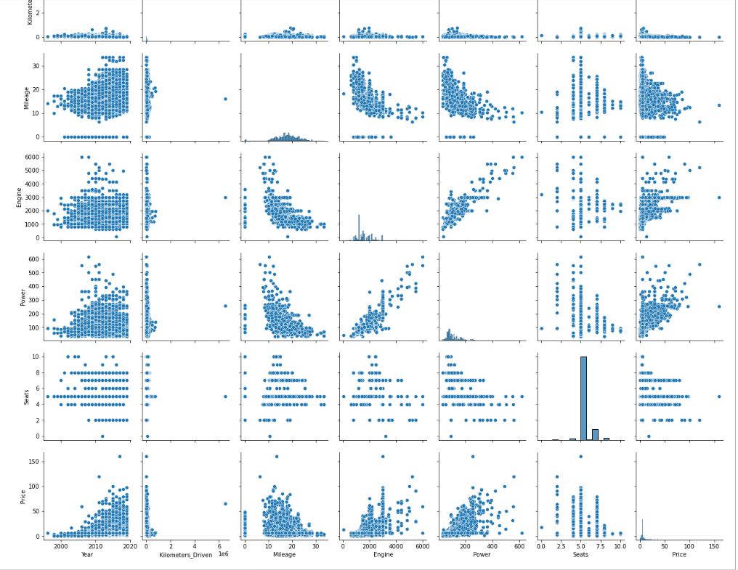
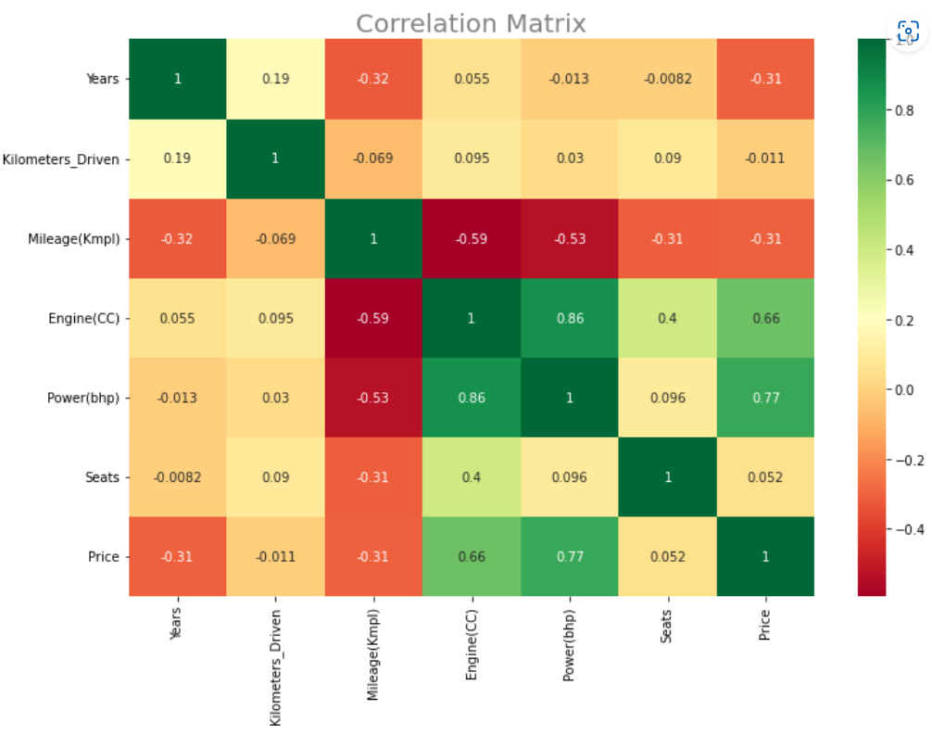

Slide 10
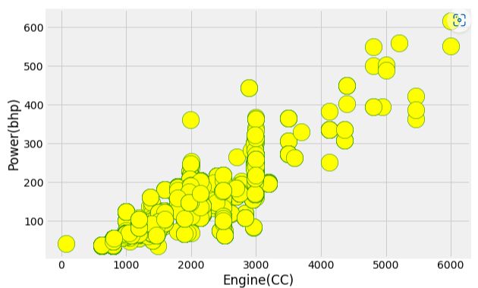
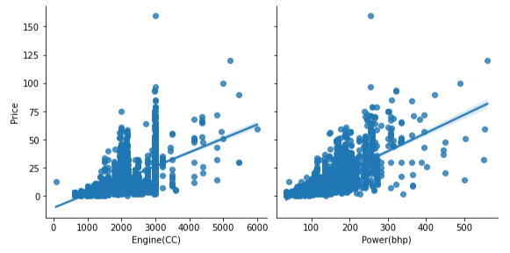
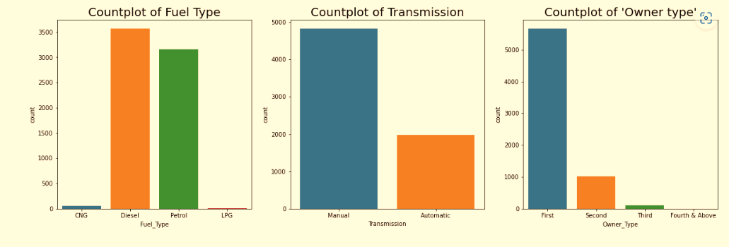

Slide 11
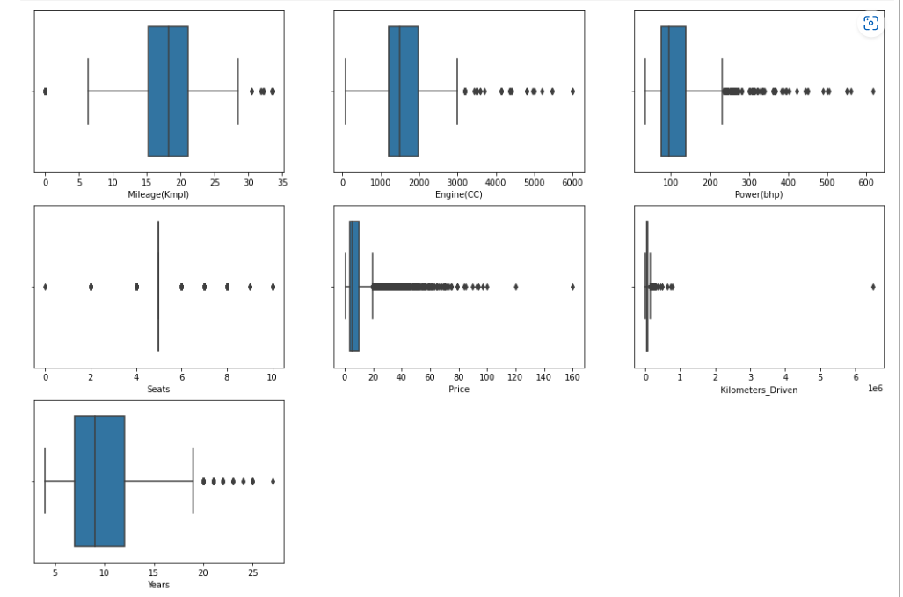
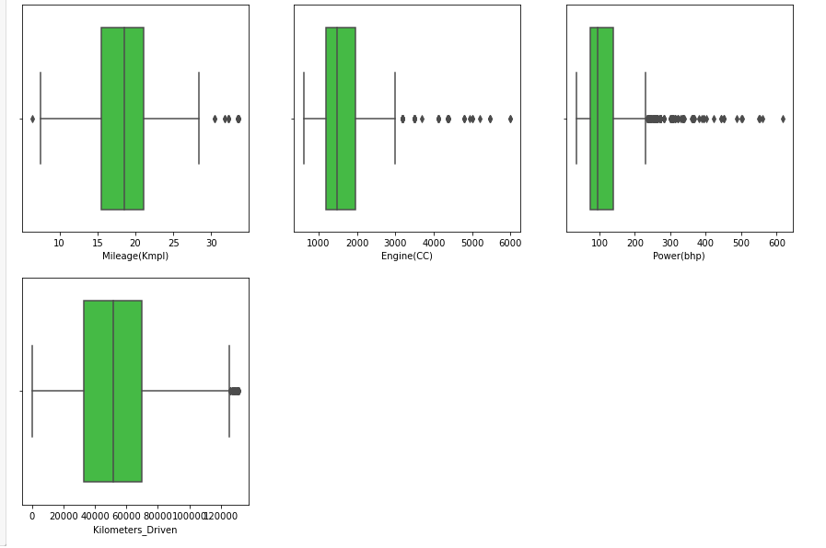
Outlier detection and treatment

Slide 12
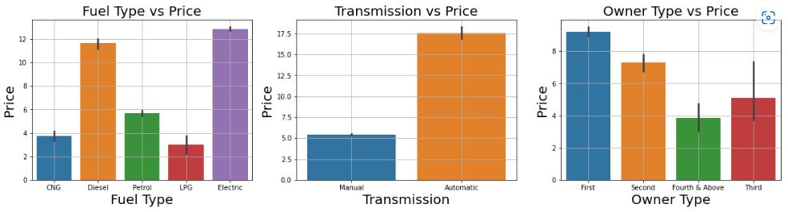
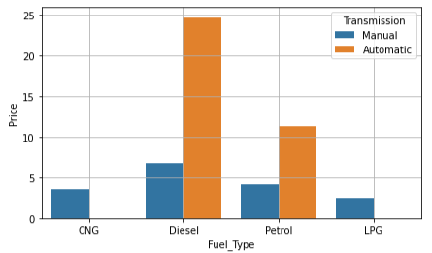
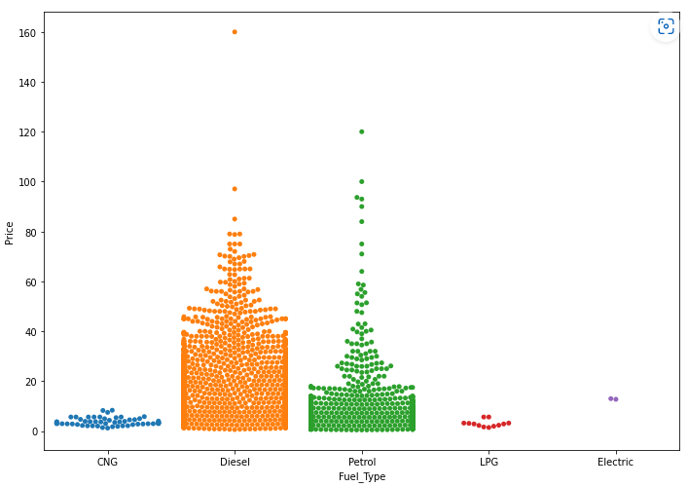
Price varies on various factors

Slide 13
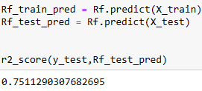
Prediction Modeling: Linear Regression
Library used: sklearn
In linear regression got accuracy as : 66 %
Random Foreset
Using Random Foreset Algorithm we got accuracy as : 75 %

Slide 14
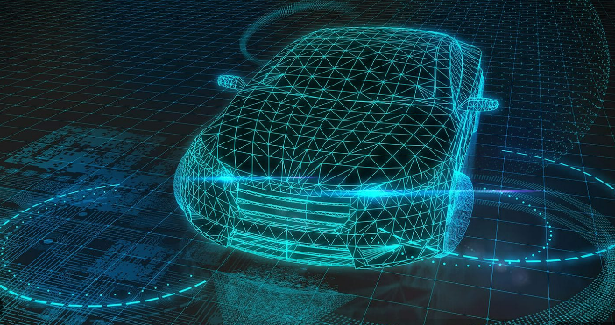


Thank you !

